Slide 1
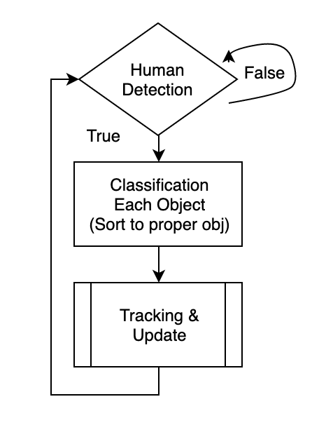
Project 1
To improve fps, used detection with tracking.
For accurate labelling, used Euclidean distance to find closest object.
To reduce brightness difference, used equalization. (no miss detection when brightness changed)
When object’s vector size is 0, It means disappeared
Notes:
used 9 function for good readability

Slide 2
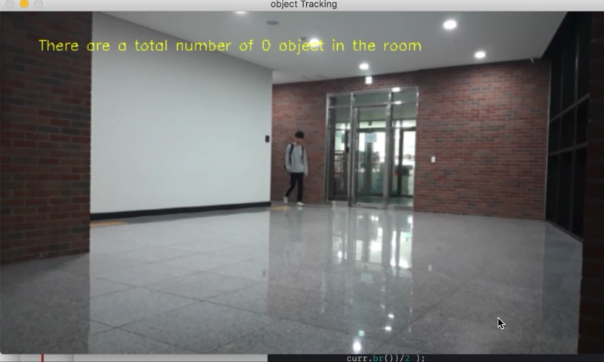
Project 1

